Slide 1
The Final Countdown
Collin Smith, Conor Burrows,
Jake Luedtke, Nicholas Melon
Notes:
More about the analysis/”story” than the data itself
Short recap of first two presentations
What did we decide to look at?
How do the graphs help us reach our goal?
Word analysis graphs
Mood & genre graphs

Slide 2

Initial Goals
What genres have the most hits?
Does the content of song title or artist name make a difference?
How have these trends changed over time?

Slide 3

Meet the Band
Conor Burrows - Metadata collection and balalaika
Jake Luedtke - Word analysis and didgeridoo
Nicholas Melon - Predictive modeling and gusli
Collin Smith - Data cleaning, graphing, and gongs

Slide 4

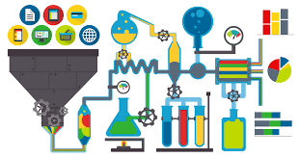
Our Data Sources:
Tsort.info - lists tens of thousands of songs from 1900-2007 (and limited data up to 2016)
Assigns a score based on song chart positions
Uses 132 source charts from all over the world

Slide 5

Data collection and Scoring
All songs in our dataset have been collected from “hit charts” around the world
Scoring Chart position
1 + (1/x) = Score
Dealing with reported sales
List of all song in order of sales
1 + (1/x) = Score
All scores were simply added together to receive a final score

Slide 6
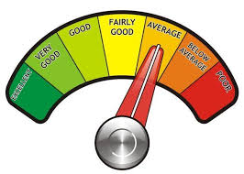
Scoring special cases
Awards such as grammys
Multi-Platinum, Platinum,ect.
1 + (1/x) = Score
Multi Platinum x =1
Platinum x= 2
Ect.
Weighting

Slide 7

Our Data Sources:
Expansive, precise music database.
Metadata you probably haven’t heard of.
Easily accessed through our API wrapper, GNAW.
Notes:
In order to answer questions about the popularity of music, we needed info from a more in-depth source. Scores and z-scores are good, but they don’t tell us what gives a song it’s “groove.” Gracenote provided us with more descriptive aspects of the music through an easy search: put in a song and artist and it will return things like tempo, genre, artist type, and even the mood the song evokes. To make things simple we wrote our own program to access Gracenote, and though we ran into some time issues along the way it still proved to be a key piece of the project.

Slide 8
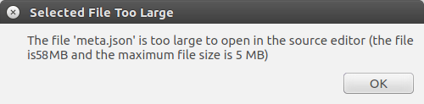
Difficulty Breakdown
Gathering data:
Initial download: ezpz/10
Gracenote collection: 6/10
Cleaning data:
Dumping a list of python dicts to json: 3/10
Json to R data frame: 7/10
Analysis:
Graphing: 6/10
Shiney: 8/10
Waiting for the API to cool down:
48,543/10
Notes:
Things to put here:
How long did gathering and cleaning take?
What was the most difficult part of each process? The process as a whole?

Slide 9
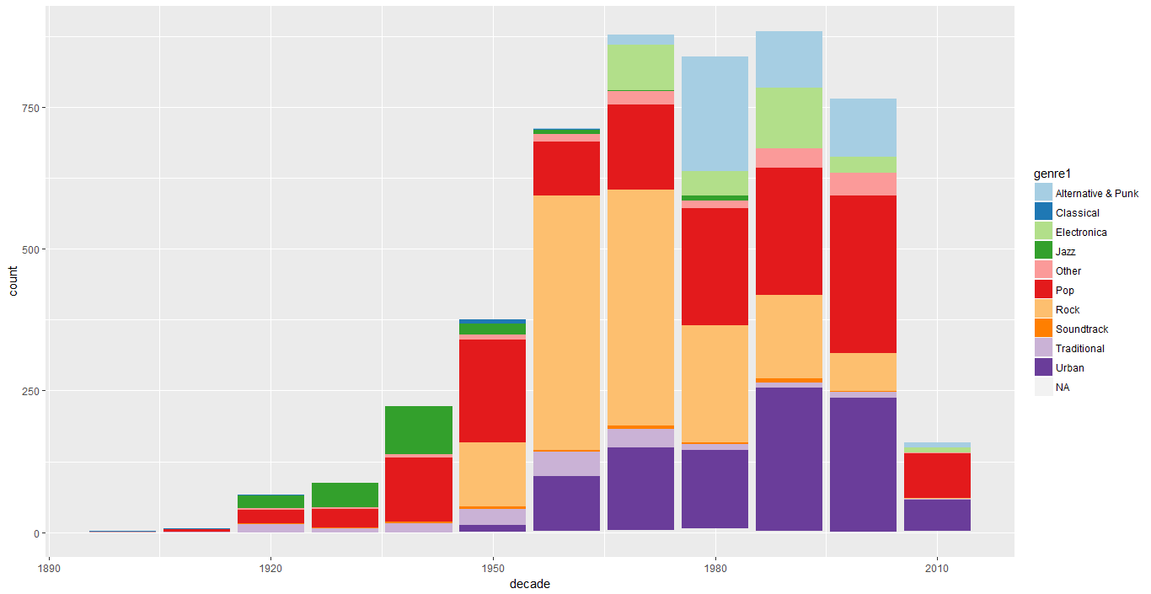
Genres Through the Years

Slide 10
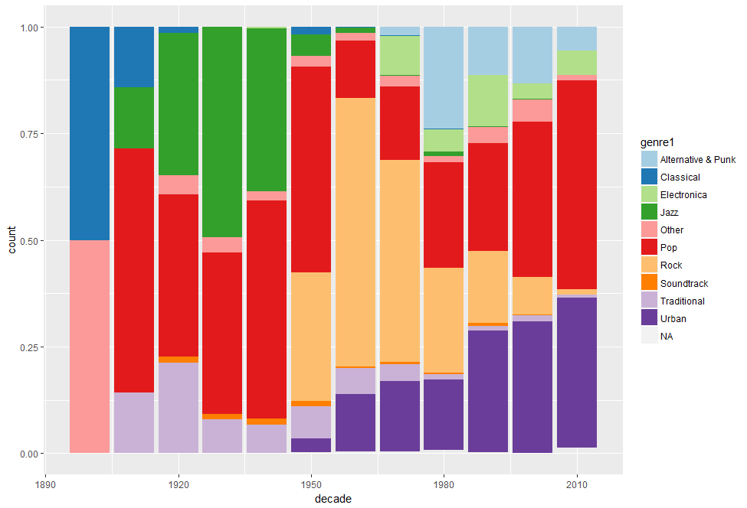
Genres Through the Years

Slide 11
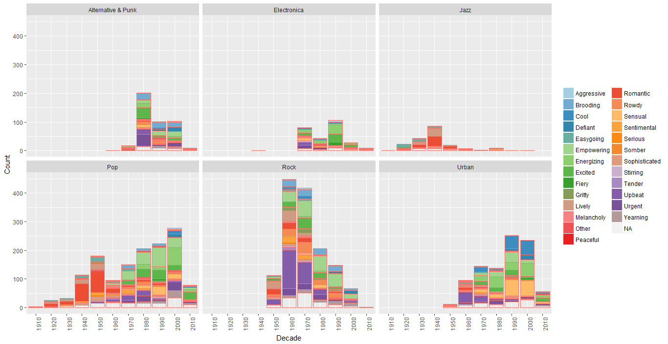
Mood and Genre Through the Years
Notes:
These charts show the distribution of moods per decade according to genre. For example, you can see clearly that the majority of “rock” music in the 1960s had an upbeat mood. In this visualization higher mood counts mean more music in that genre, which generally corresponds to that genre’s popularity in the specified decade.
It is also worth noting that data from the 2010s is only partially complete- it only goes up to 2015 when the decade was half over!

Slide 12
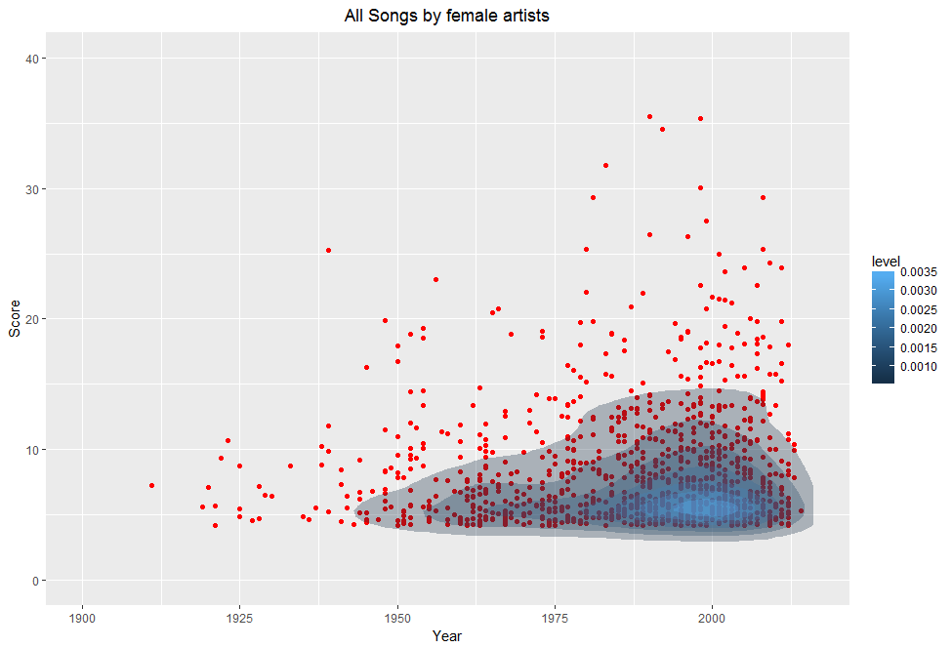
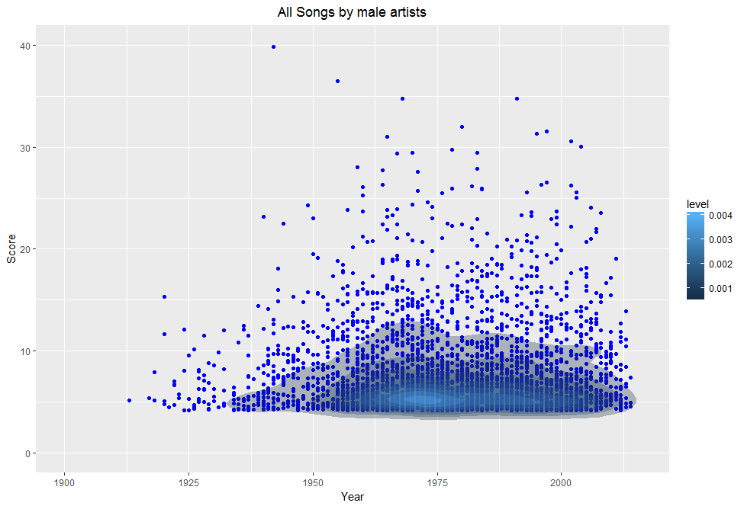
The Gender Gap

Slide 13
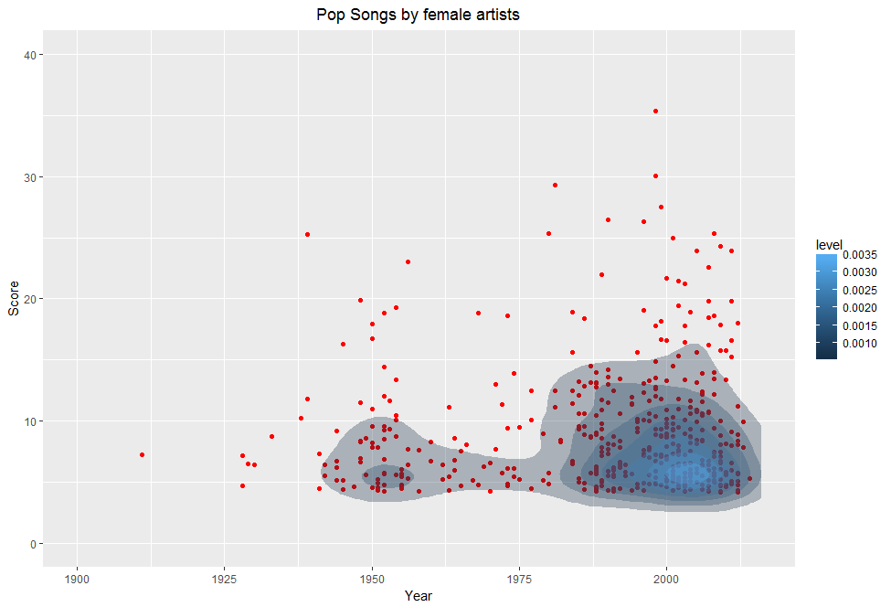
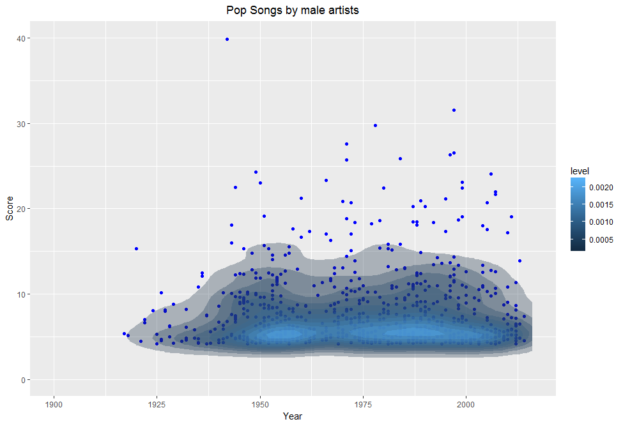
The Gender Gap: Pop

Slide 14
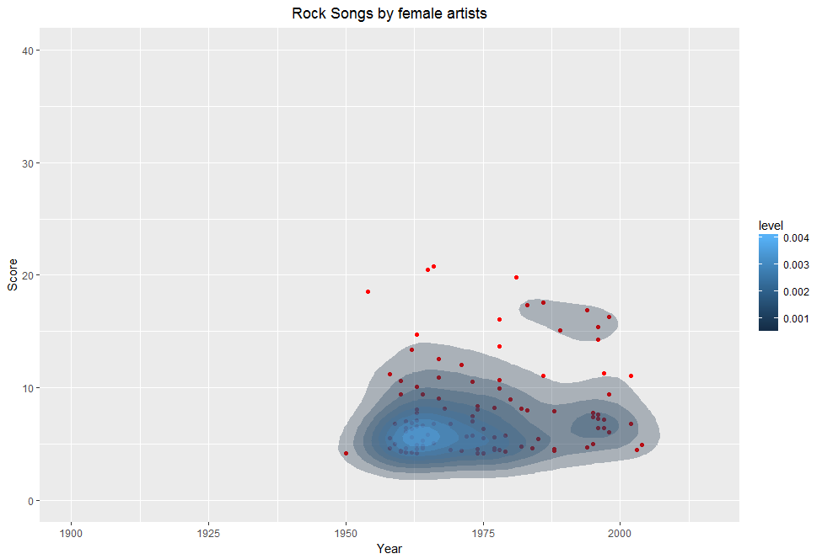
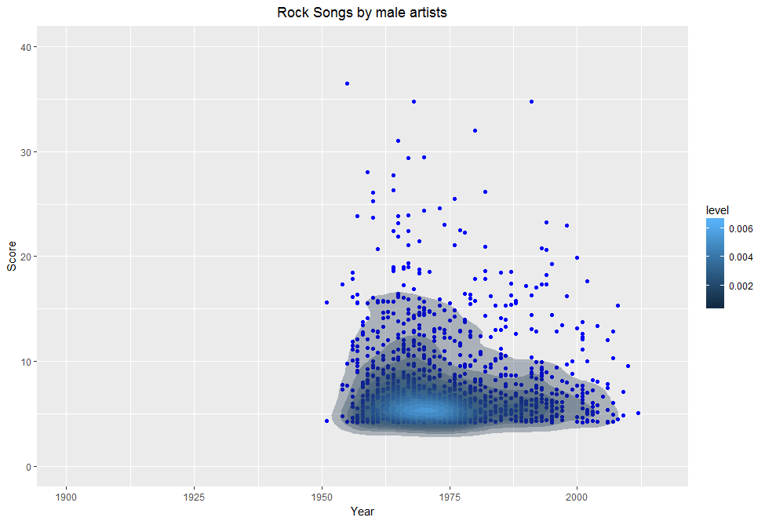
The Gender Gap: Rock

Slide 15

Predictive modeling
Can we predict the genre of a song based on score, year, and tempo
How about just score and year
What is KNN modeling
Our success rate

Slide 16
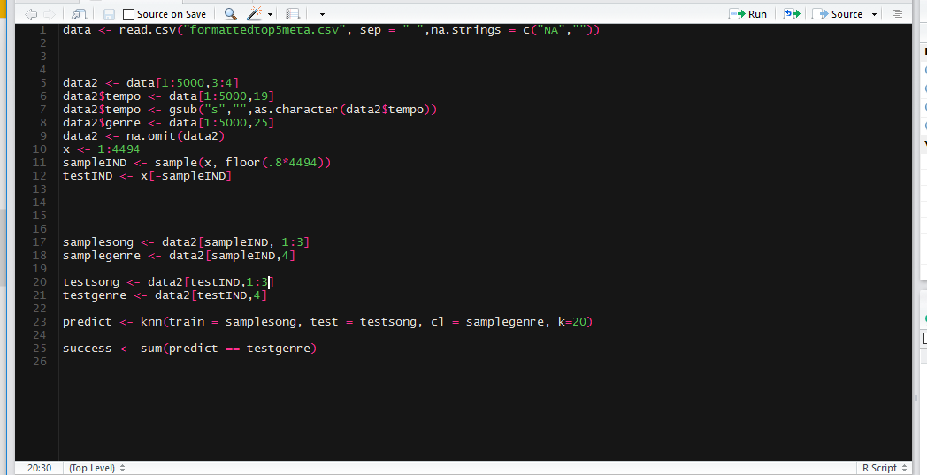
Implications of the model
Songs of similar genre got similar scores in the same year
Tempo appears not to affect the genre a song is grouped into
Attempts to predict score

Slide 17

Word analysis
Wanted to see if certain words had affect on its popularity
Also what words where use in specific genres/moods
First looked at count for the 48000 dataset
Got an average score for each word
Not enough meta data

Slide 18
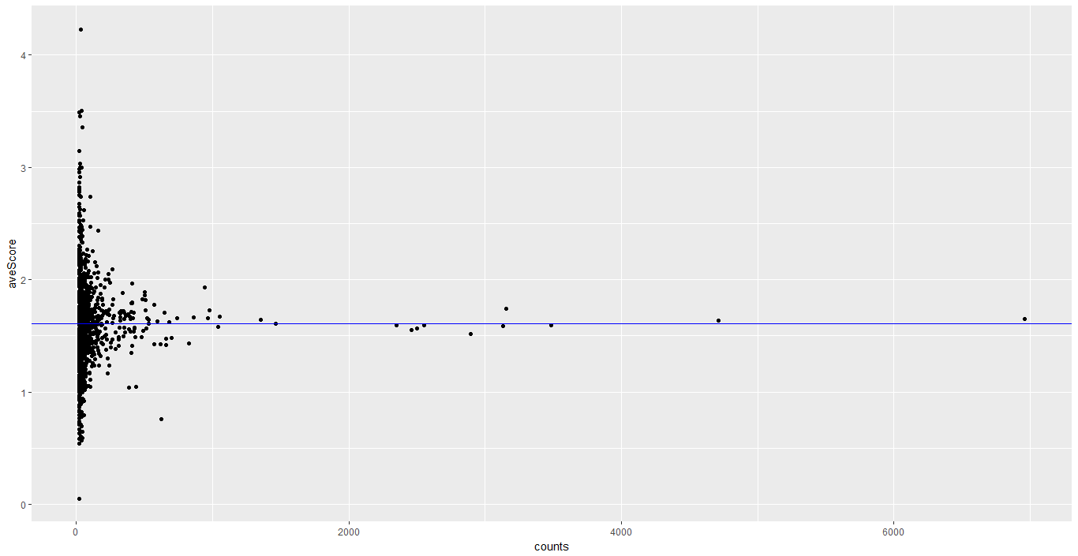
Word analysis: Average Scores

Slide 19
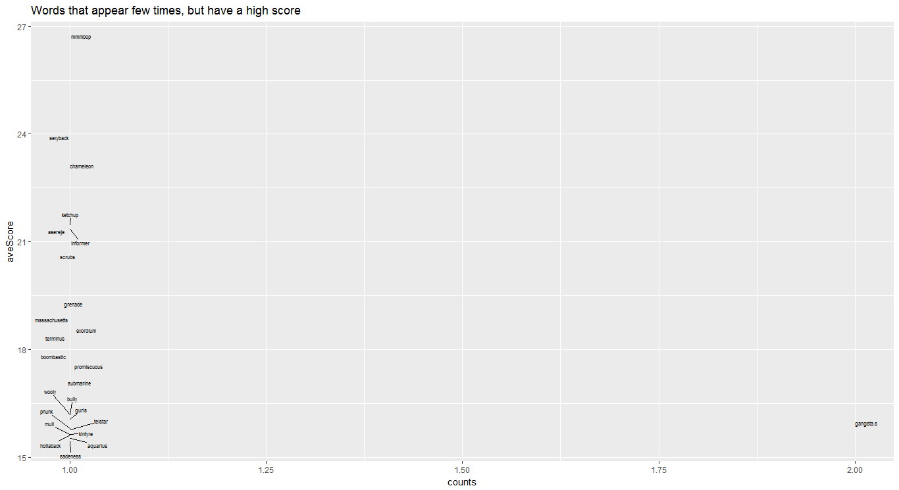

Slide 20
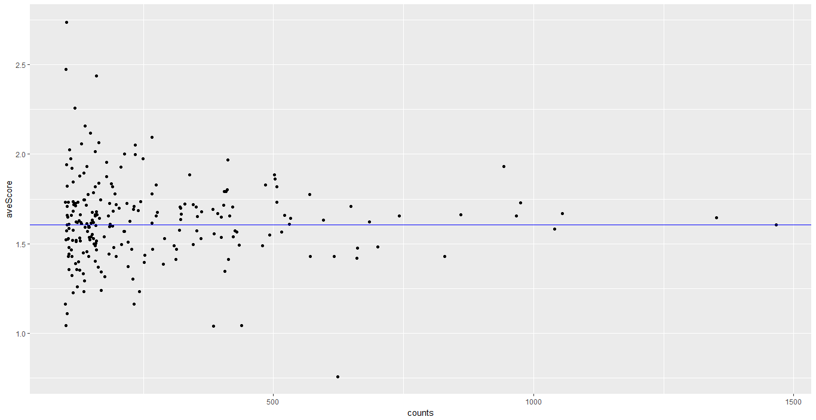
Word analysis: Average Scores

Slide 21
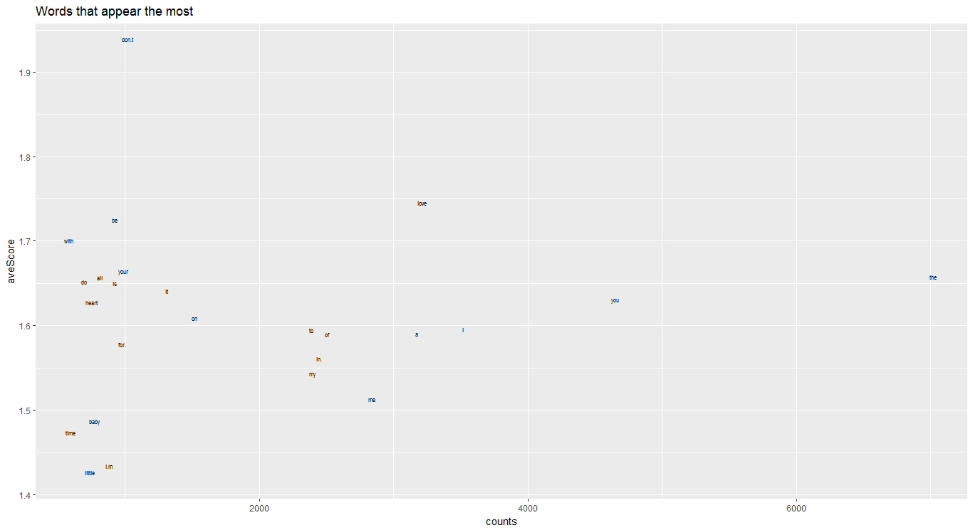

Slide 22
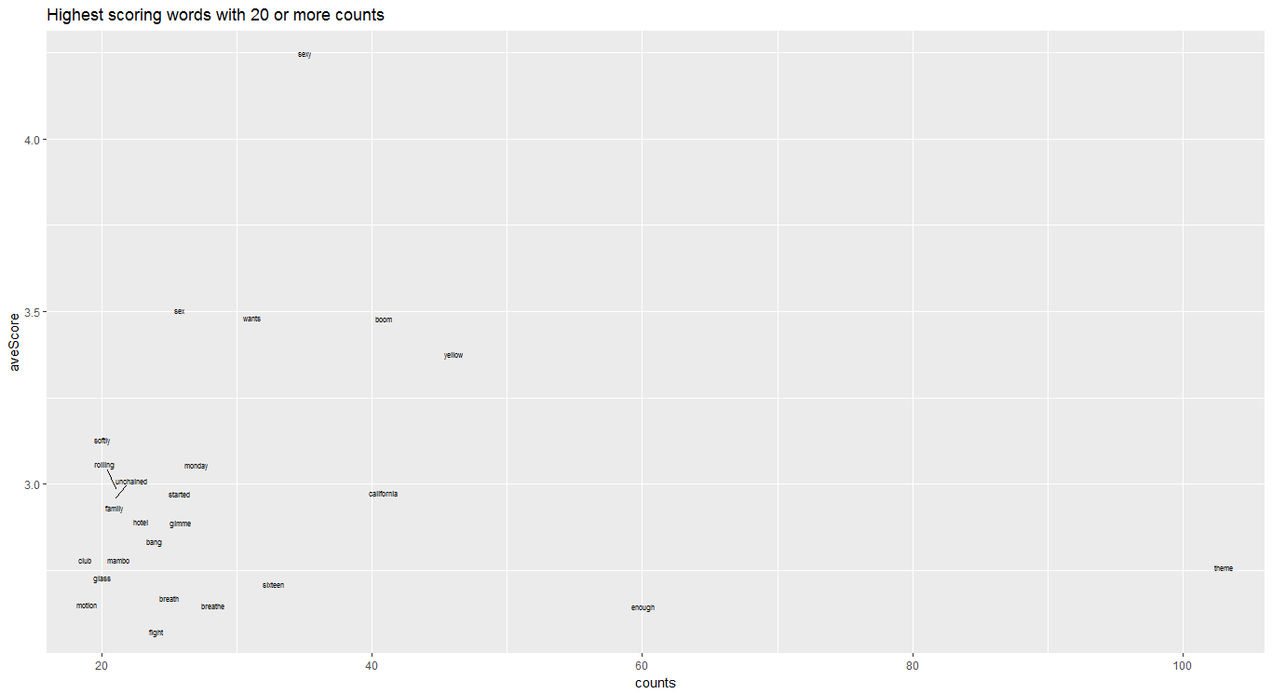

Slide 23
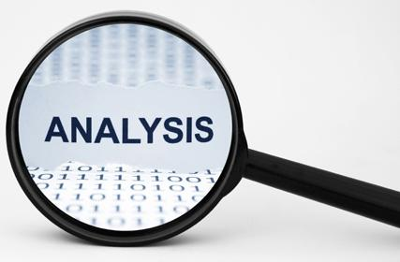
Word Analysis Cont.
Made word count for top 5000
Once metadata was acquired analyzed that
Definitions for words matched genre/mood

Slide 24
Dashboard and Shiny App
Dashboard contains searchable list
Contains the average data for each word
Shiny plots scores by year for user selected genre and mood

Slide 25
Conclusions
Trends in music taste have changed
Songs in general have become more energetic (empowering, upbeat)
A word's definition (usually) reflects its mood
Little correlation between word and its popularity
https://github.com/MusicProject255/MusicResearch

Slide 26

For the future
Create an accurate regression to predict the score of a song
Add more songs to the dataset
Acquire more metadata for songs

Slide 27
Questions?

